Slide 1

dataTrack
QSLVN Developer Team
Pham Huynh Nhat Huy (pham.huy@qsl.net.vn)
Lam Quang Huy (lam.huy1@qsl.net.vn)

Slide 2
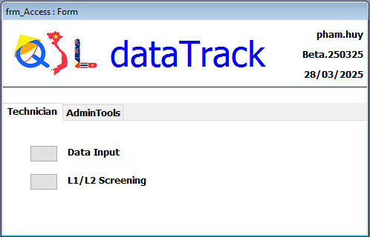
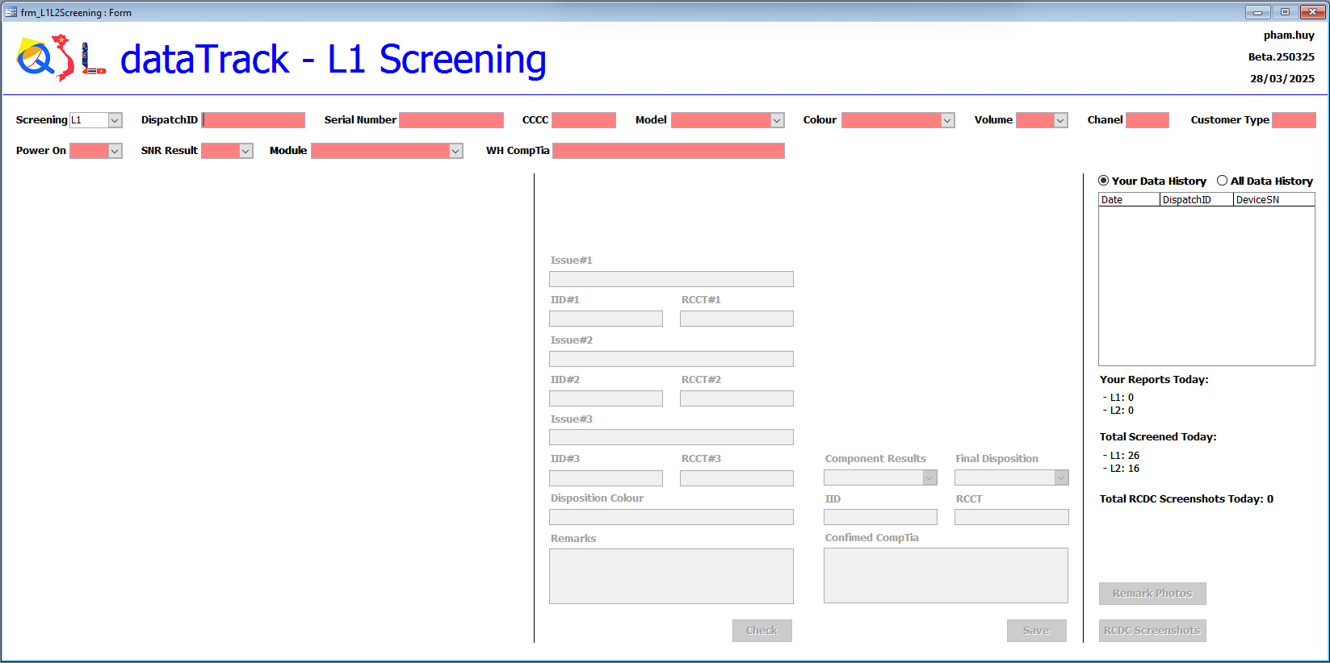
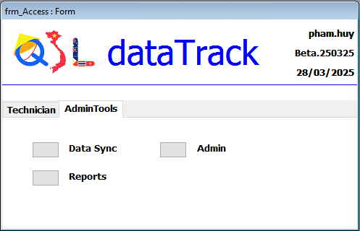
Form interface

Slide 3
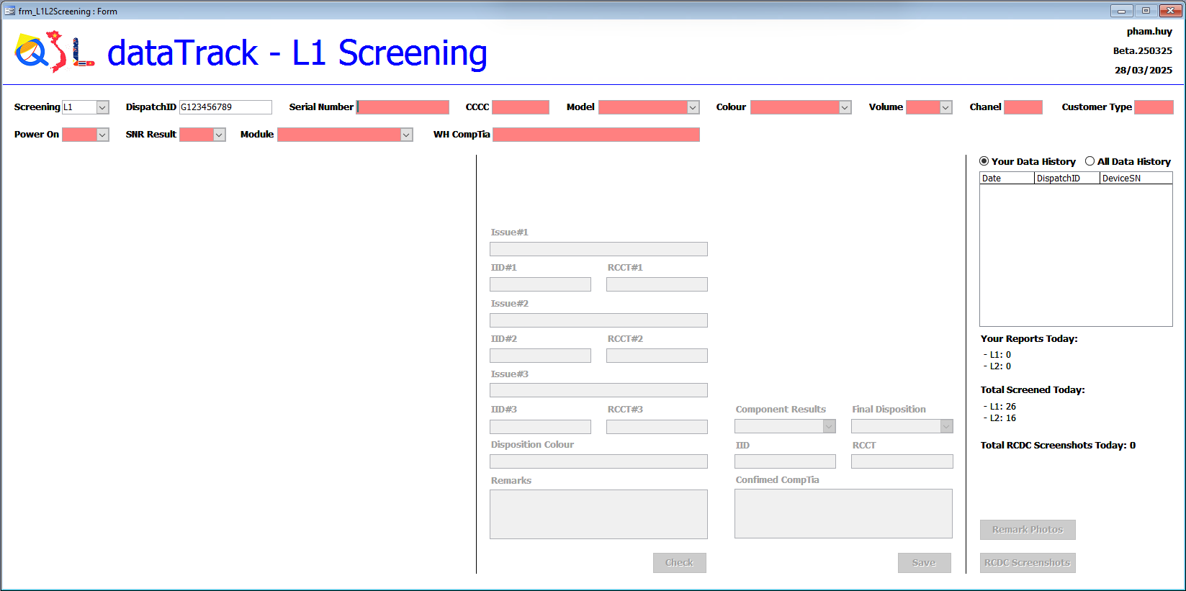


Dispatch ID
Exactly 10 characters: 1 letter and 9 digits.
Not exactly
If the Dispatch ID exists in the database, show all related data.

Slide 4
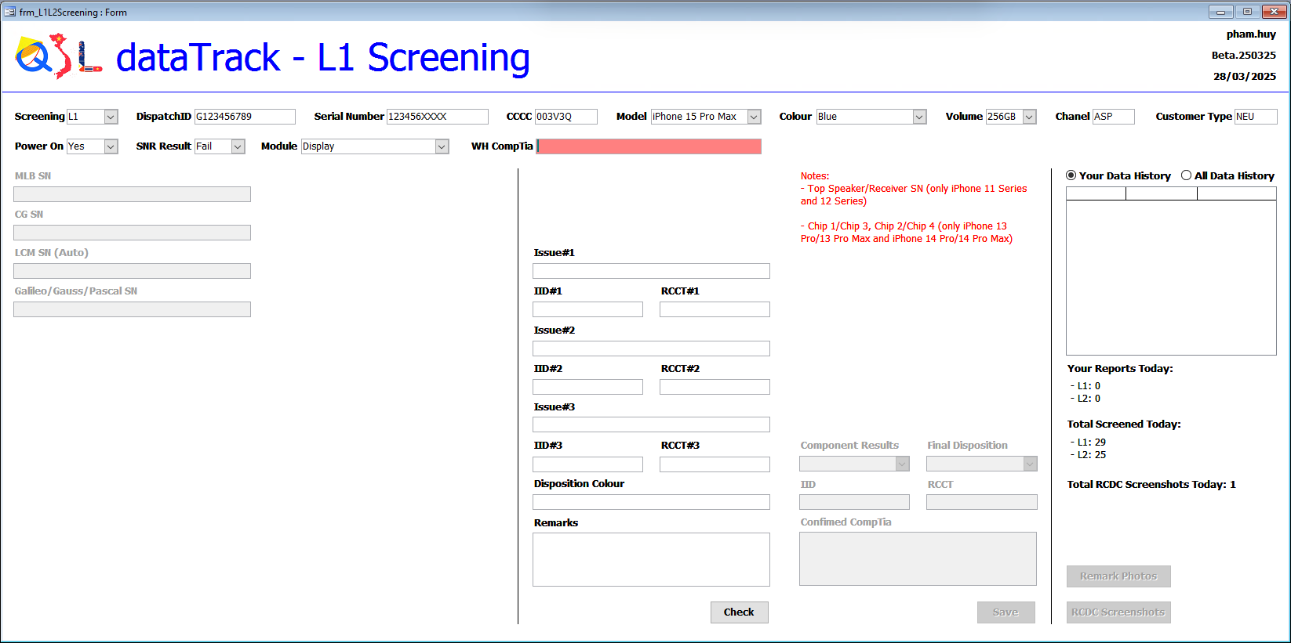
Module
After selecting the Module and Model, the system will use the Location file in the database to determine and display the notes and required scan fields.

Slide 5
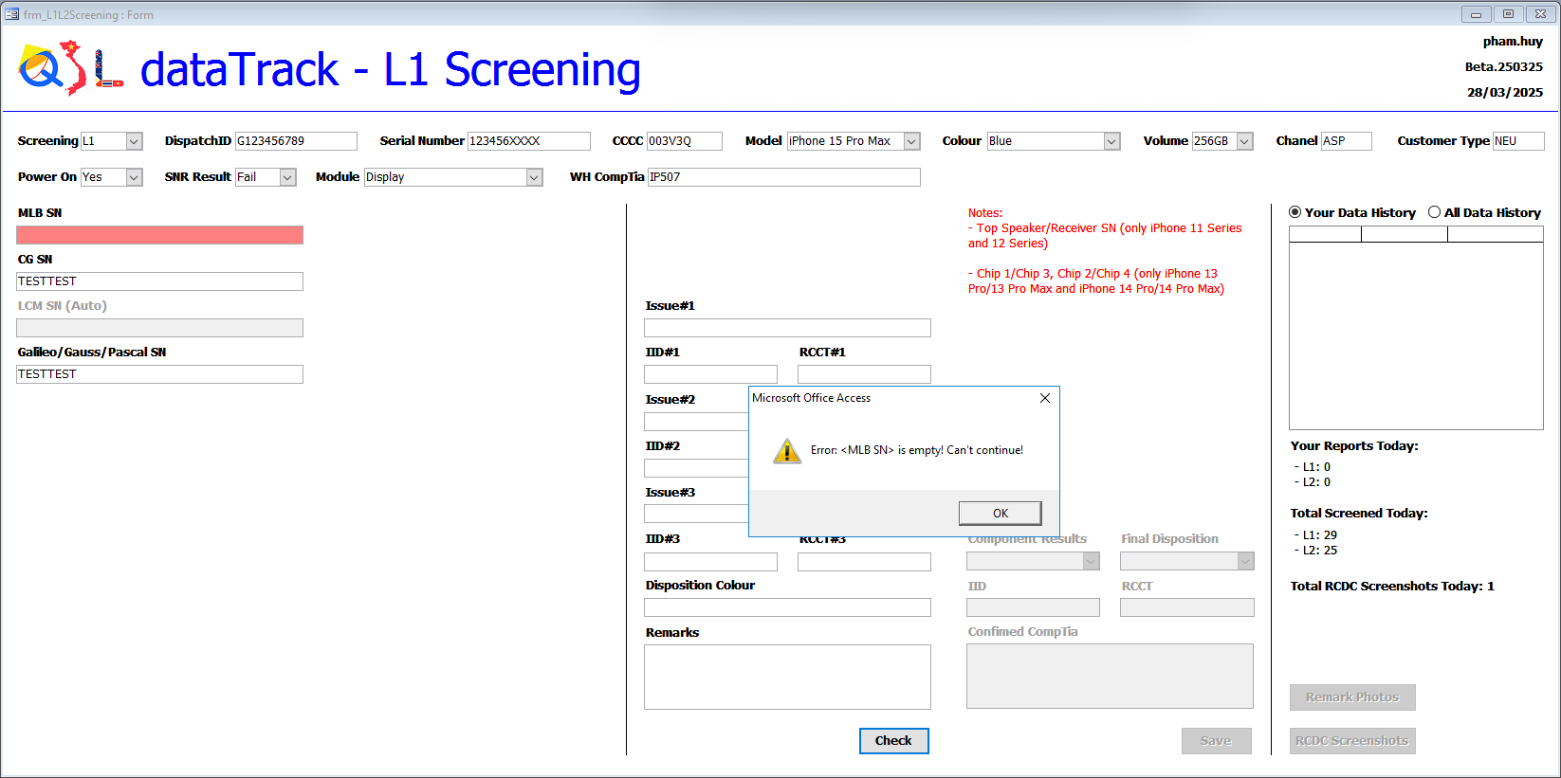
Scan the required fields
The system will report an error if a required field is left blank.

Slide 6
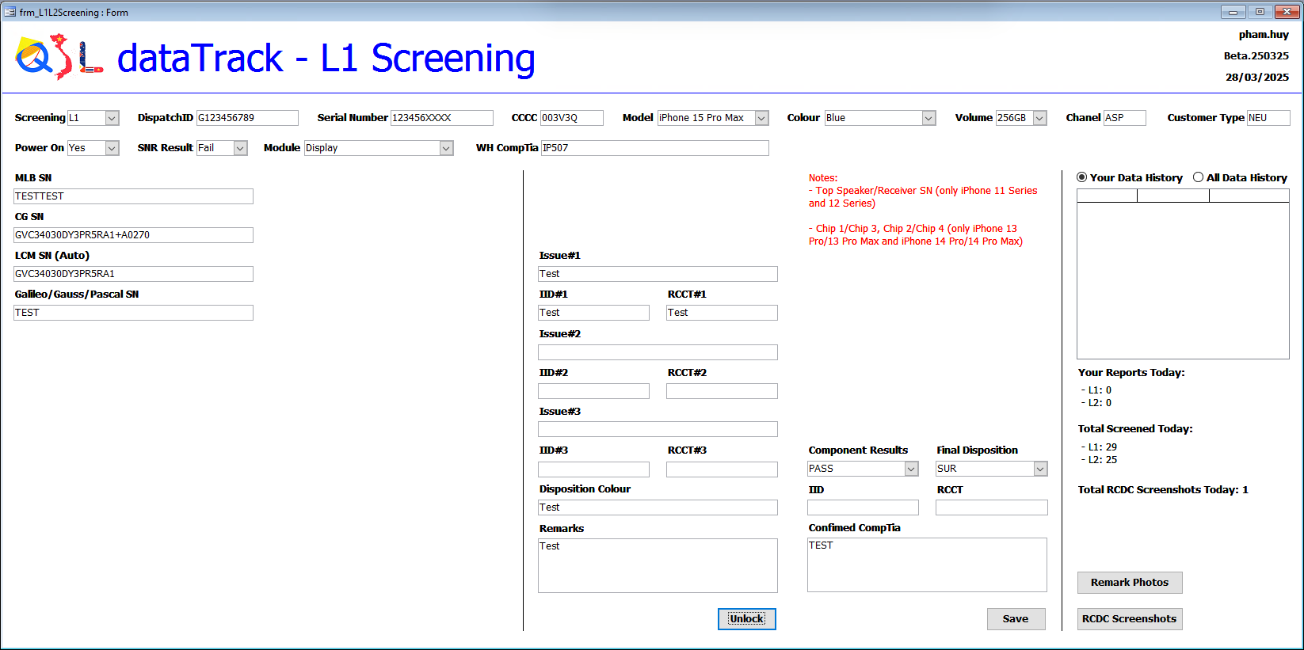
Scan the required fields
Depending on the case, entry may or may not be required.
If all conditions are met, the fields will be locked. To edit, click Unlock.
Click Save → Yes.

